Slide 1
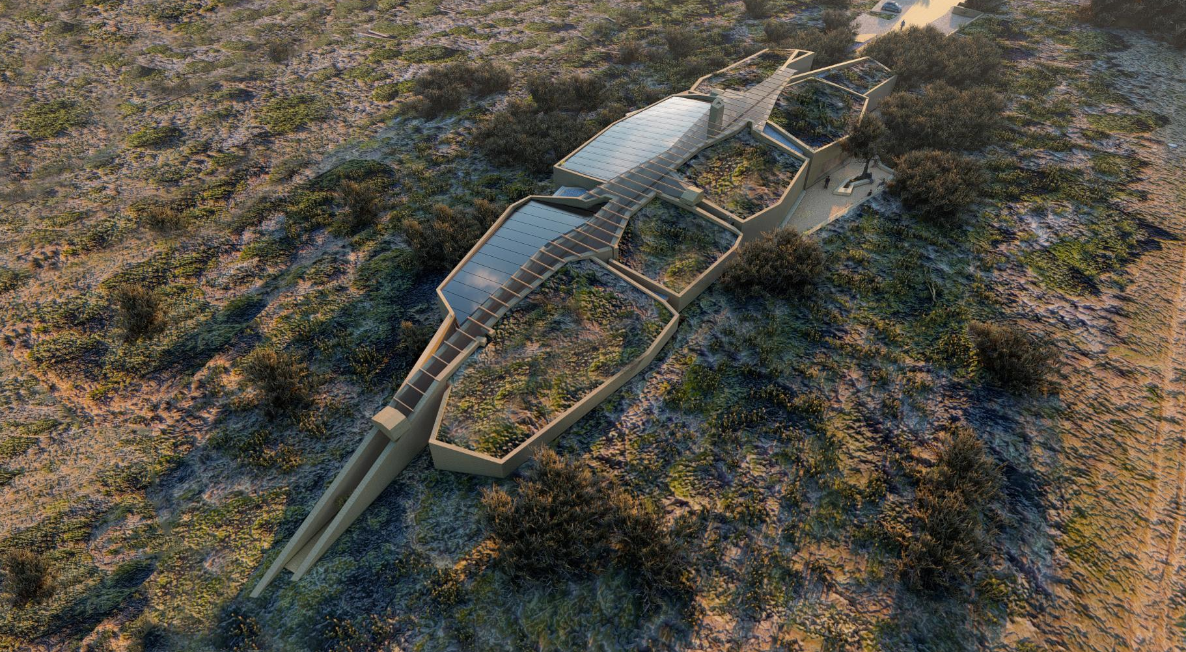
Invest in the
Hessequa Heritage
Centre for Archaeology
Stilbaai, Western Cape
South Africa
FUNDING PROPOSAL
Establishment of a unique world class heritage centre for archaeology
It will exhibit evidence how the modern human, Homo sapiens survived and developed from at least 160 000 years ago
This 2000m² building will be a main tourist attraction

Slide 2
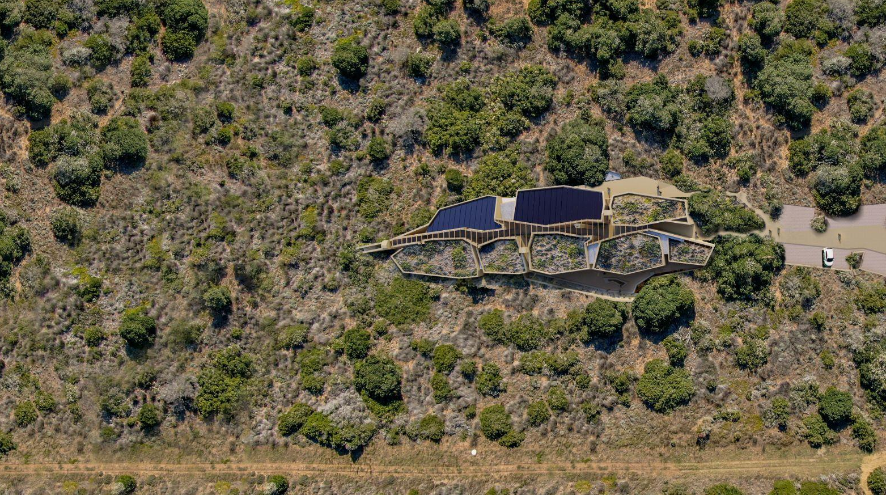
The building
Green & Sustainable building – 90% carbon free
Built using – local sand and stone
Roof – natural light, solar panels and roof gardens
Unique design – informal organic reminiscent of cave-like spaces
Destined to be a tourism attraction in its own right

Slide 3
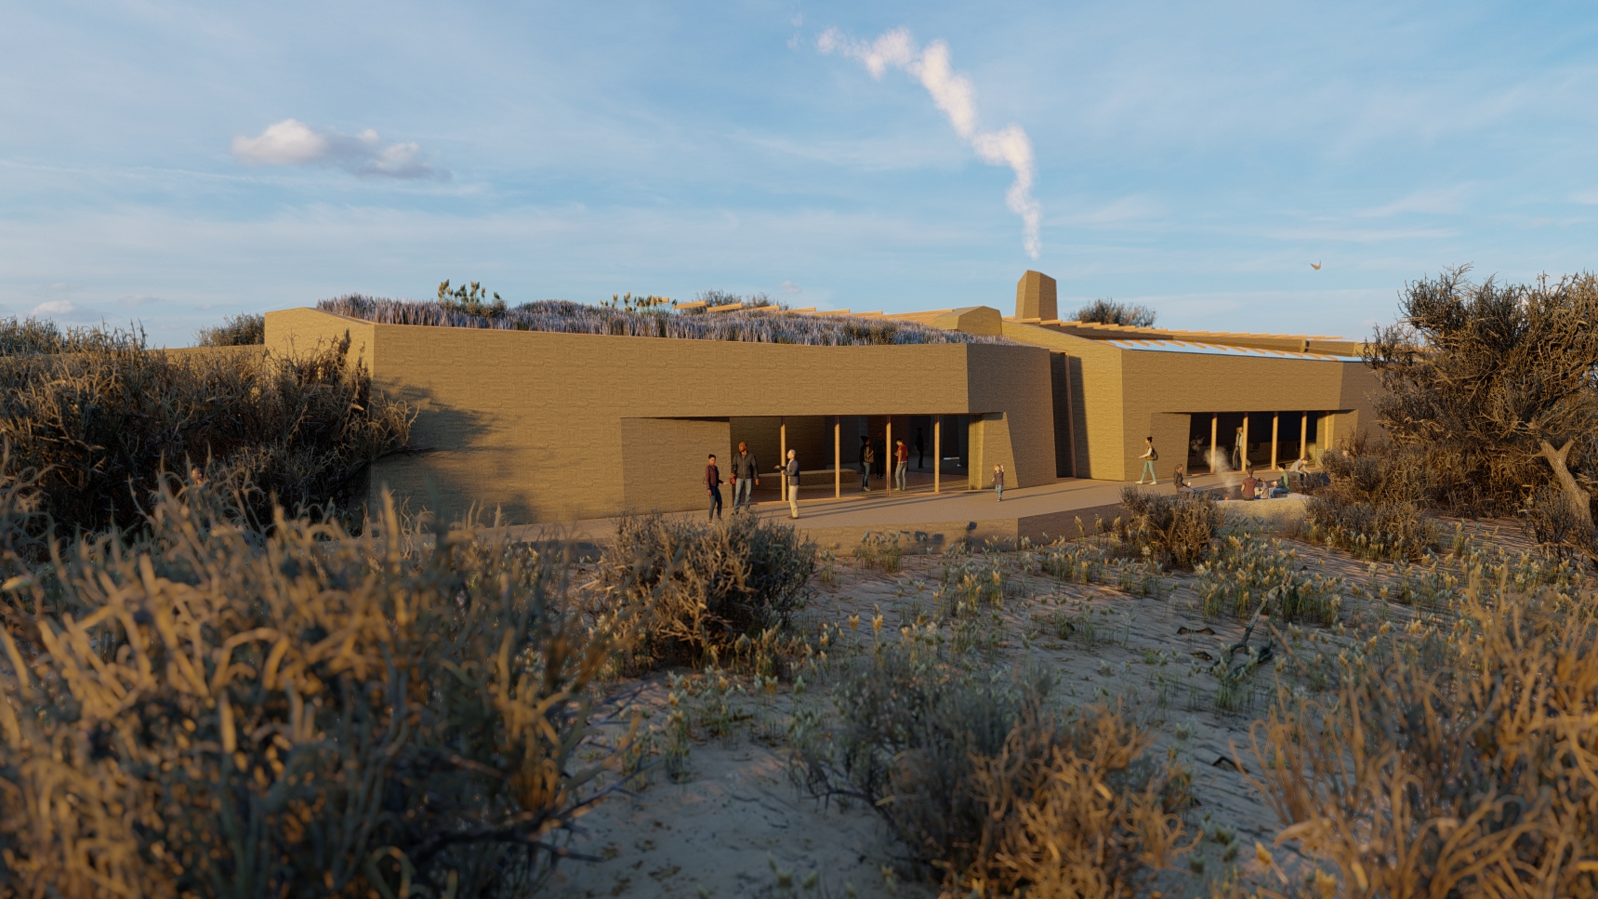
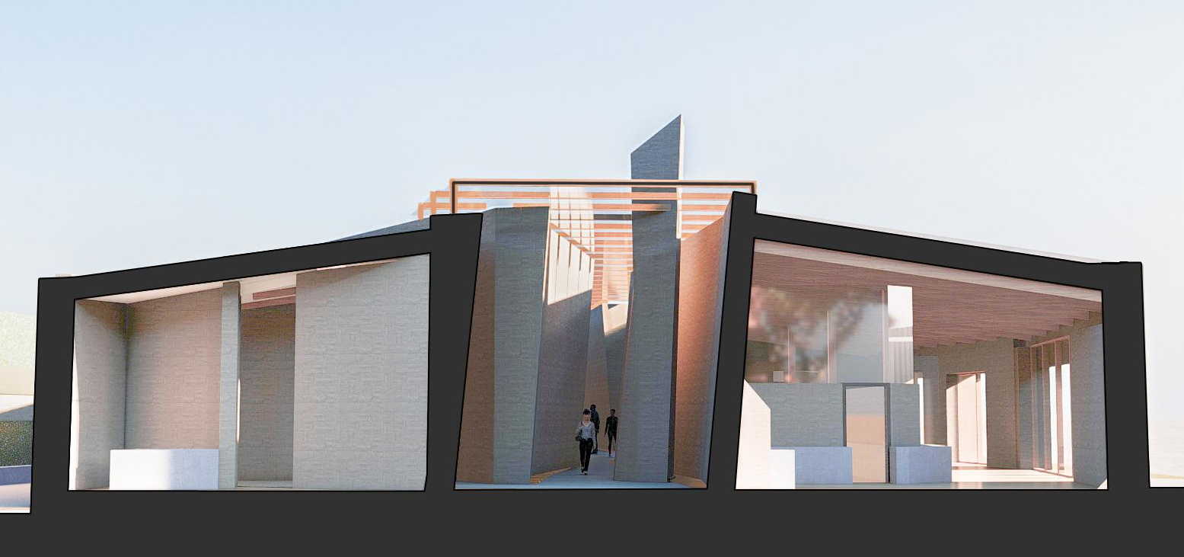
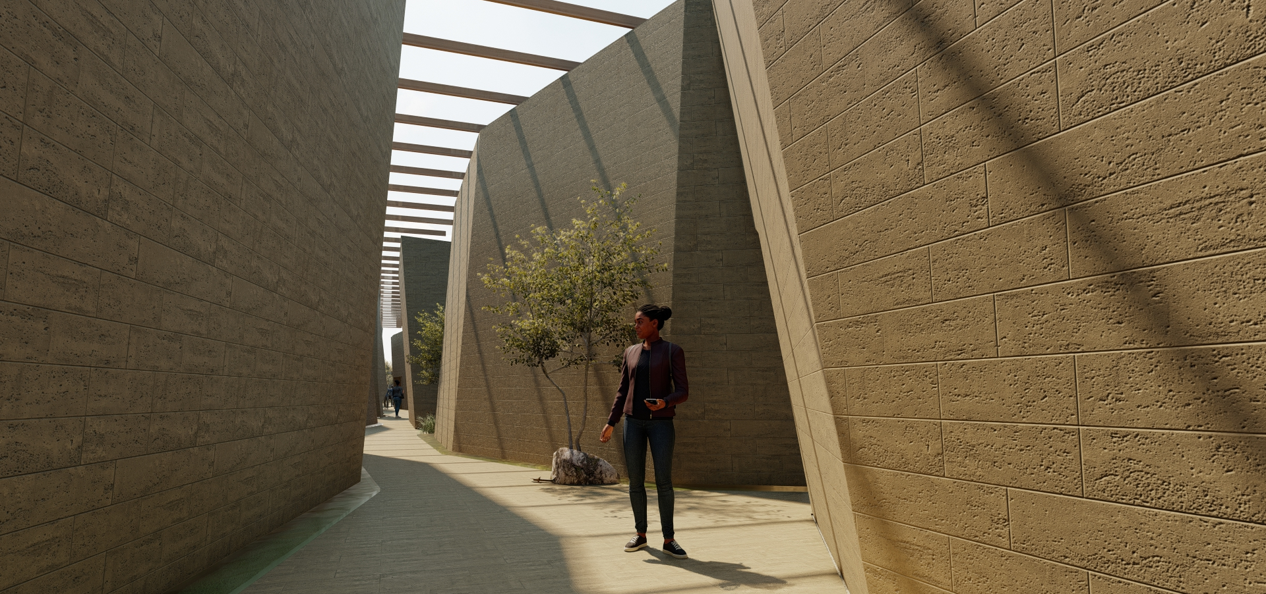
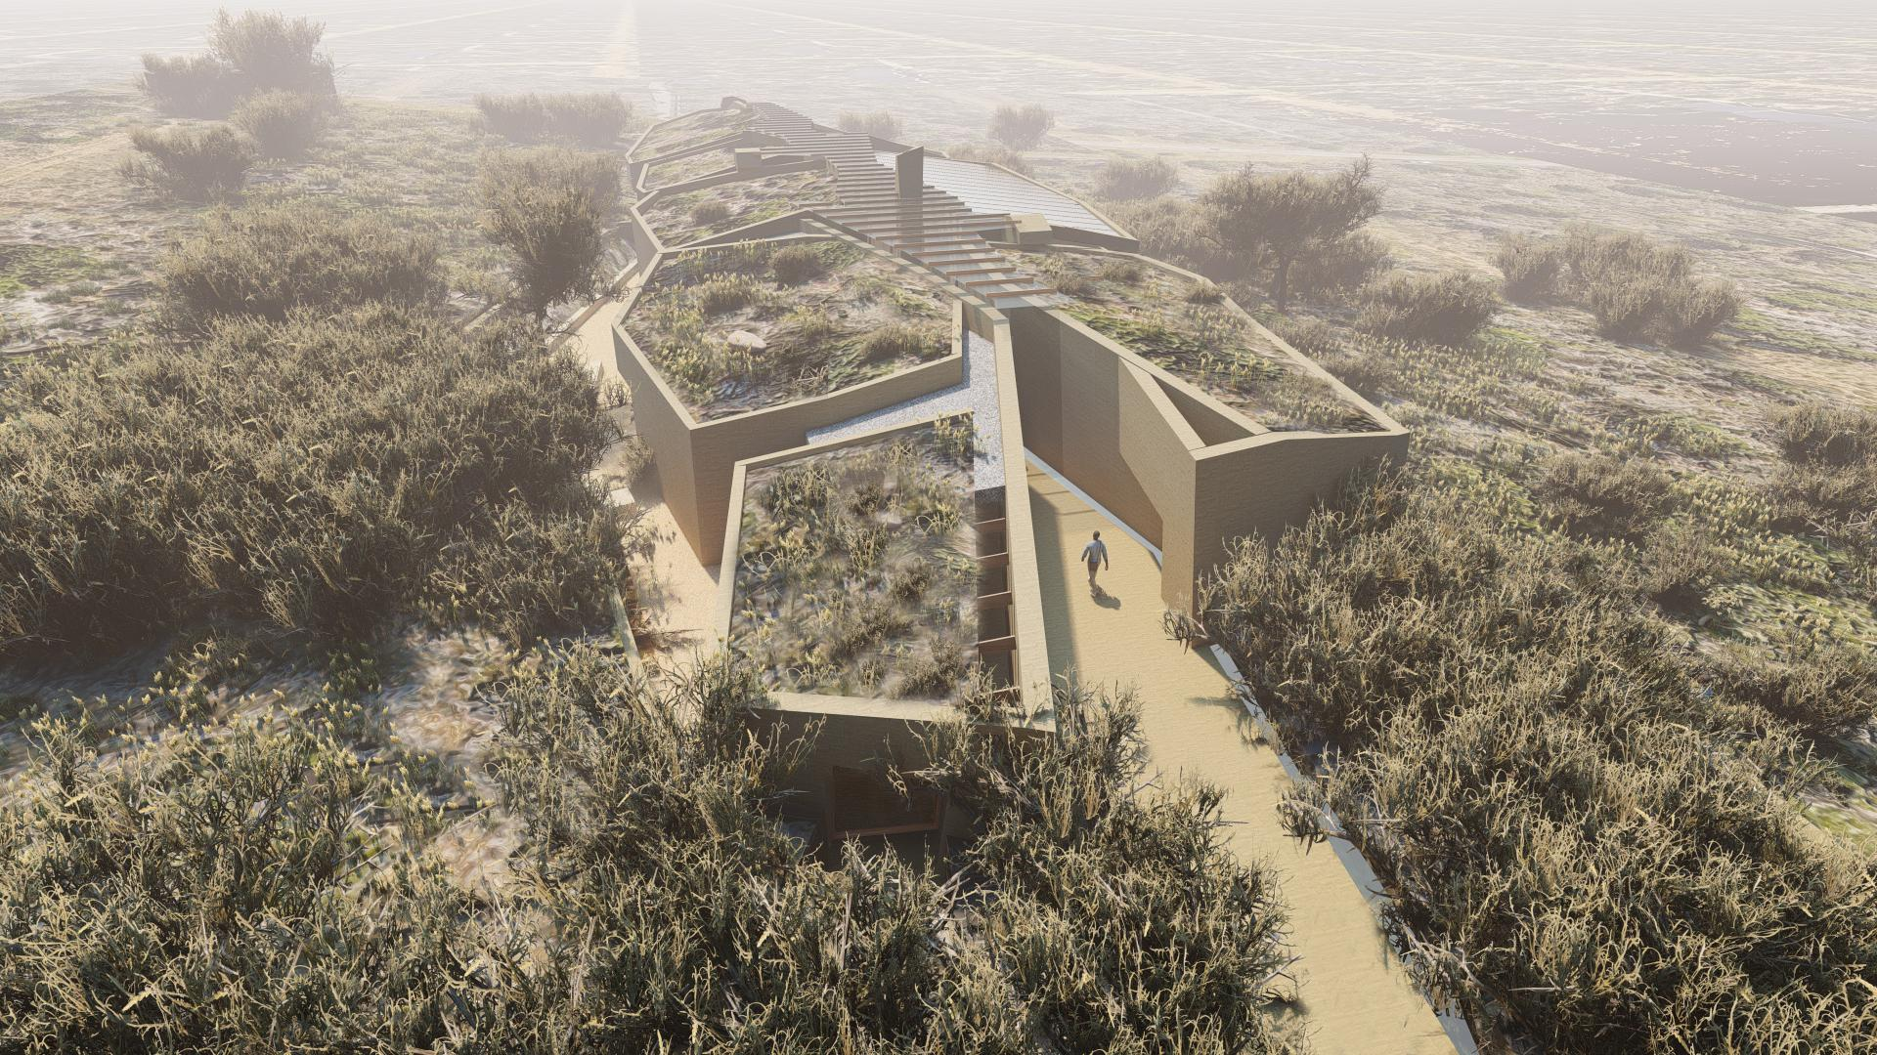
The building and content
The building consists of:
Three exhibition halls
Laboratory and repository
Conference facility
Coffee, lounge & gift shop
Office and reception facility
Outdoor activities

Slide 4
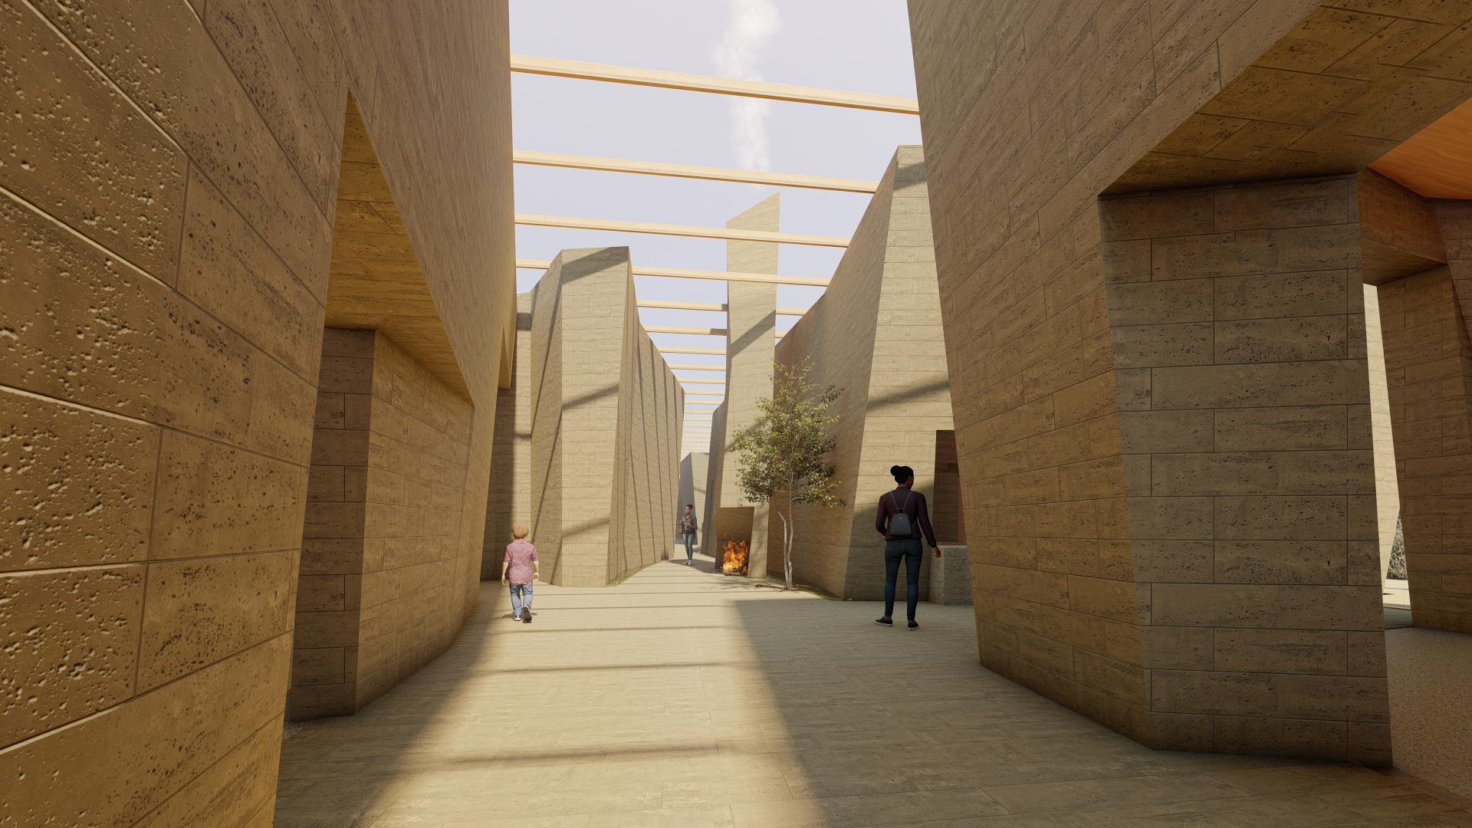
Exploring the Centre
Unique exhibition content:.
Significant evidence from various archaeological excavations and research projects
Research evidence of the landscape environment from 170,000 years ago
Selection of ancient rock art
Interactive archaeology education
cooking with indigenous plants
making tools with fire
excavating mock archaeological sites
puzzle-building with broken ostrich eggs
3

Slide 5
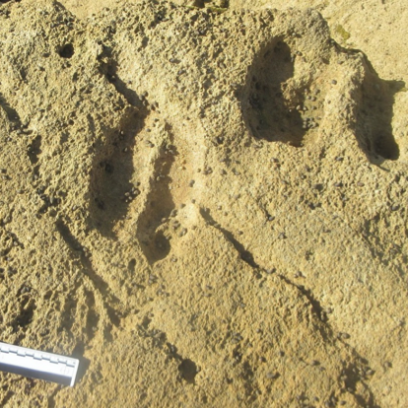
Landscape exhibition hall
This section will showcase the appearance of the landscape over 170,000 years ago
Fossilised human trackways
Illustration of how the Agulhas bank was exposed during the ice ages
Animal & bird trackways
Drawings and patterns in the sand made at least 130,000 years ago
Shell Middens and what we learn from it

Slide 6
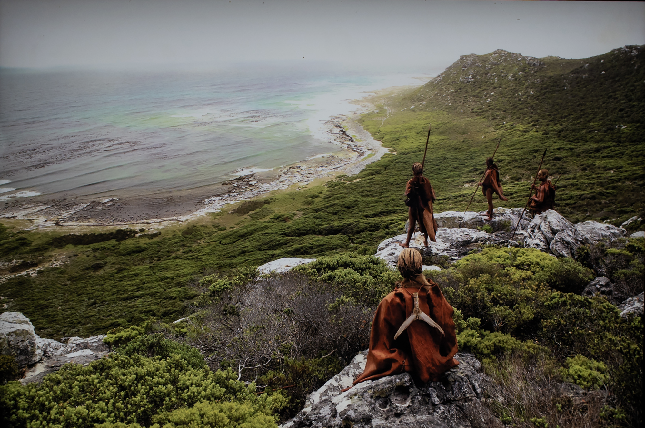
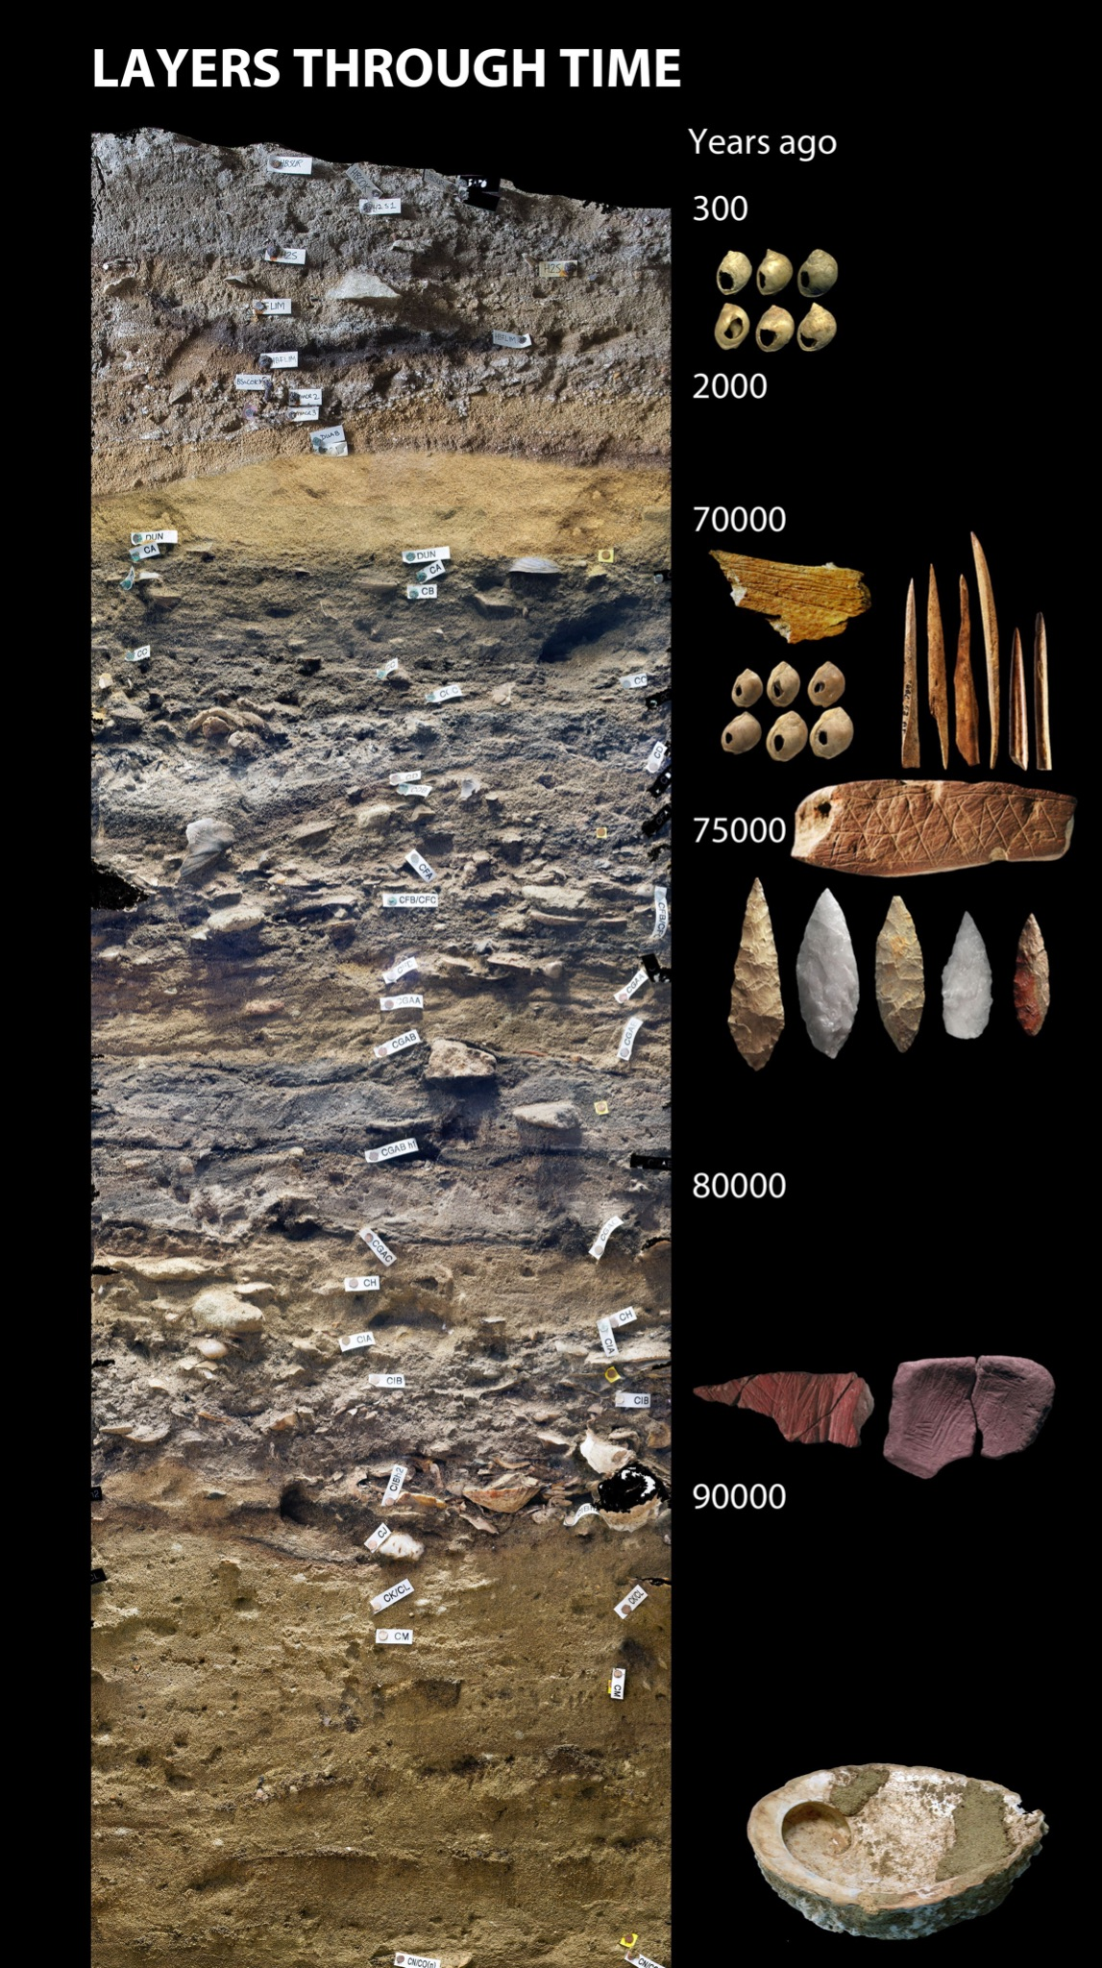
Early Human origins exhibition hall
Display the some of the oldest and most significant discoveries of the emergence of modern human behaviour in the world
From Blombos Cave:
The oldest drawing, a piece of quartzite rock dating back to 73 000 years ago.
A piece of engraved ochre dated back to 75 000 years ago, along with some of the first evidence of body decoration
The oldest “artist’s toolkit” a 100 000-year-old ochre-processing workshop

Slide 7
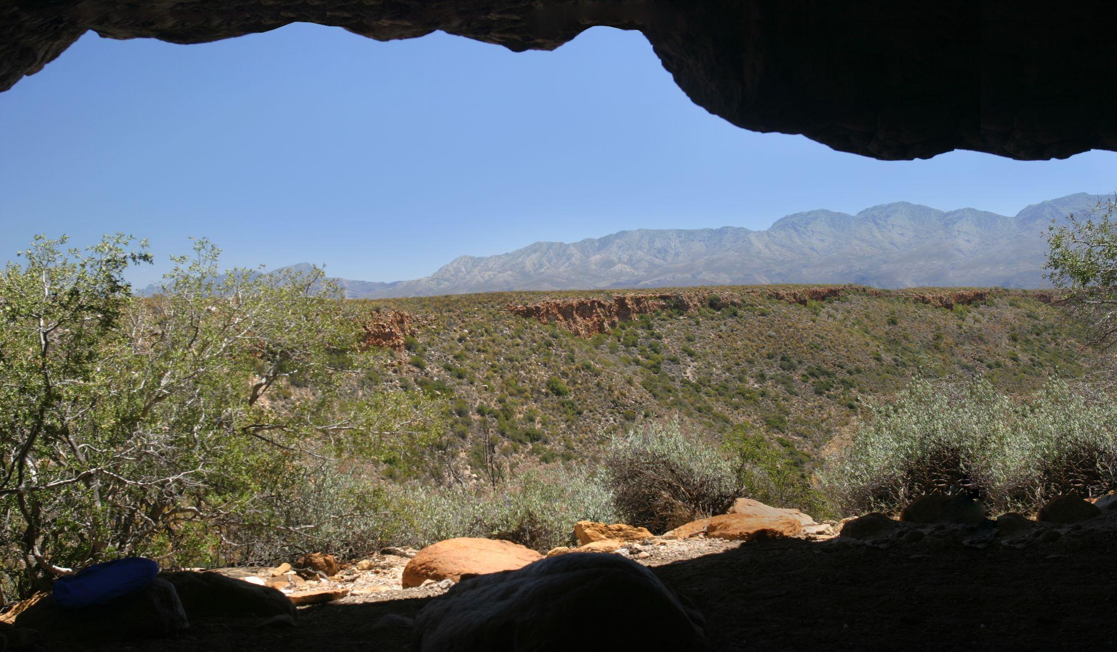
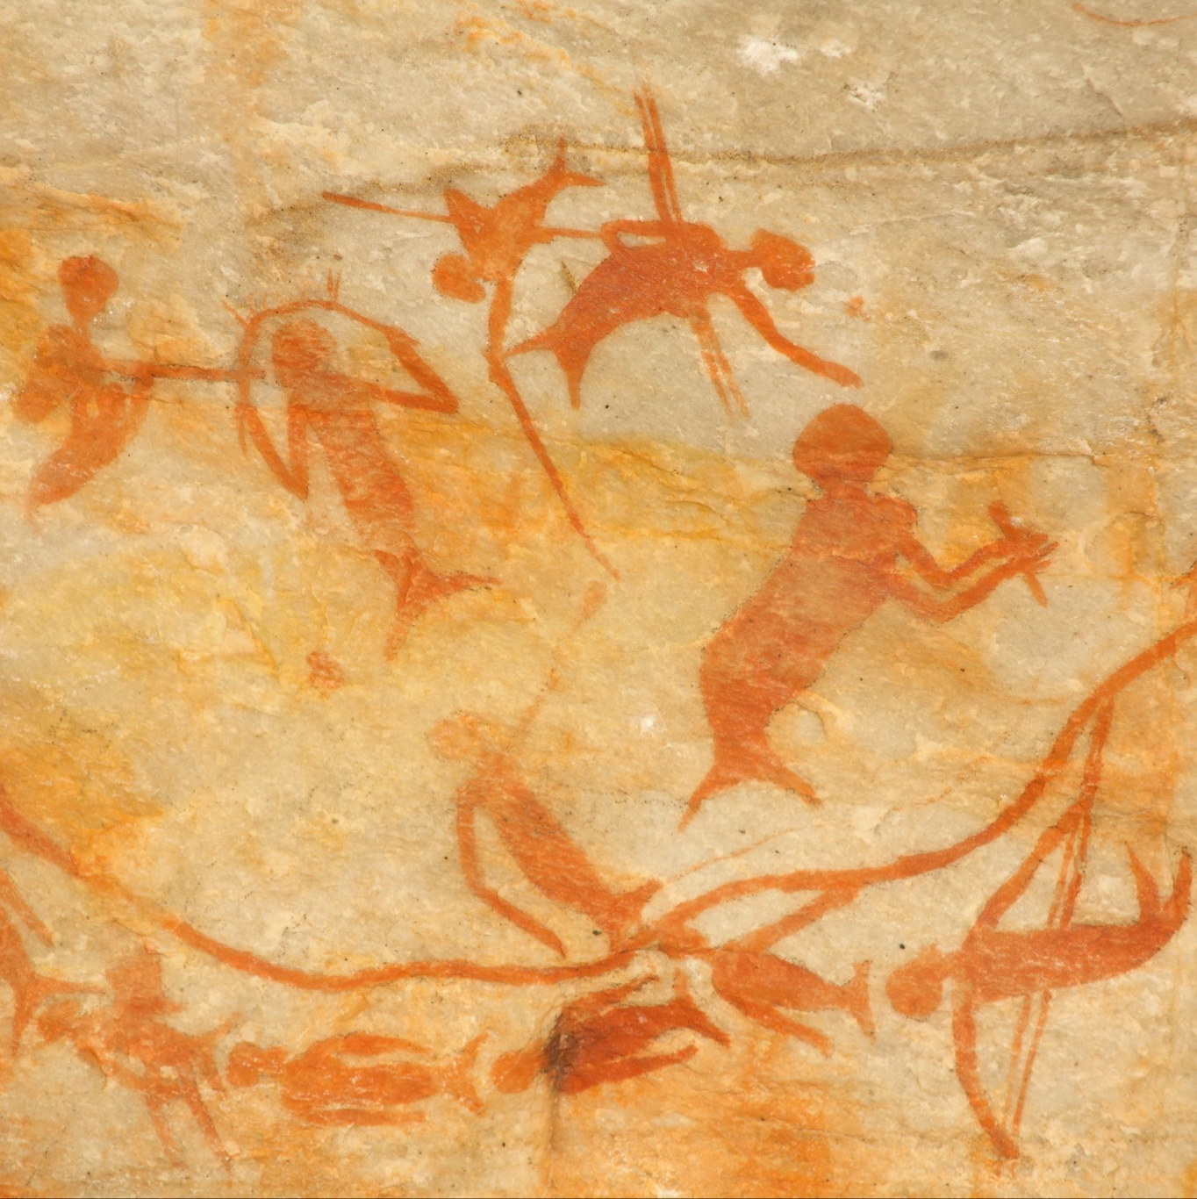
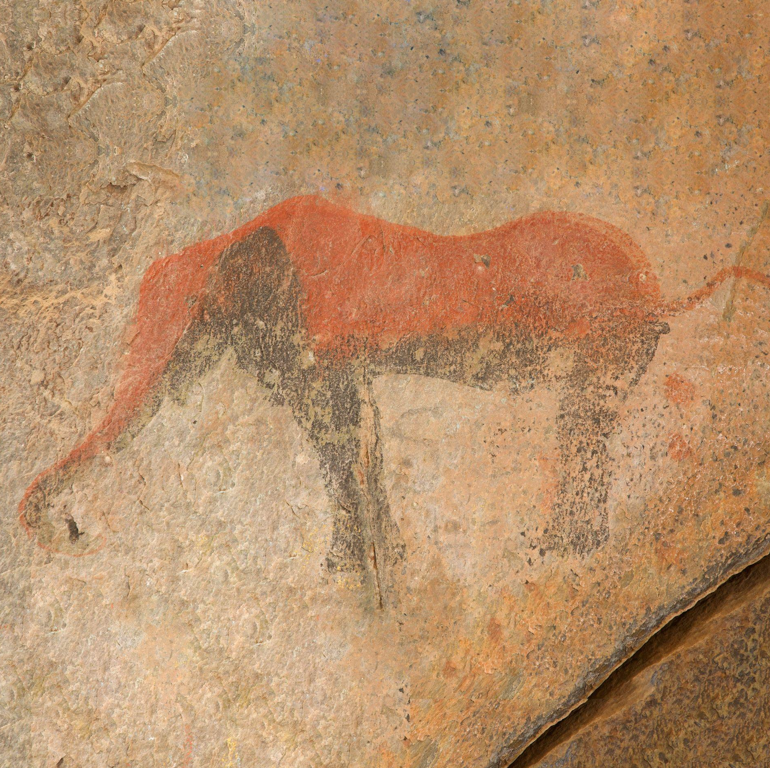
Rock Art exhibition hall
Displays ancient art images from various sites
The emphasis will be on art, interpretation, preservation and conservation
Religious and ritual symbolism
Elephant
Image of body transformation
Image of engraved animals

Slide 8
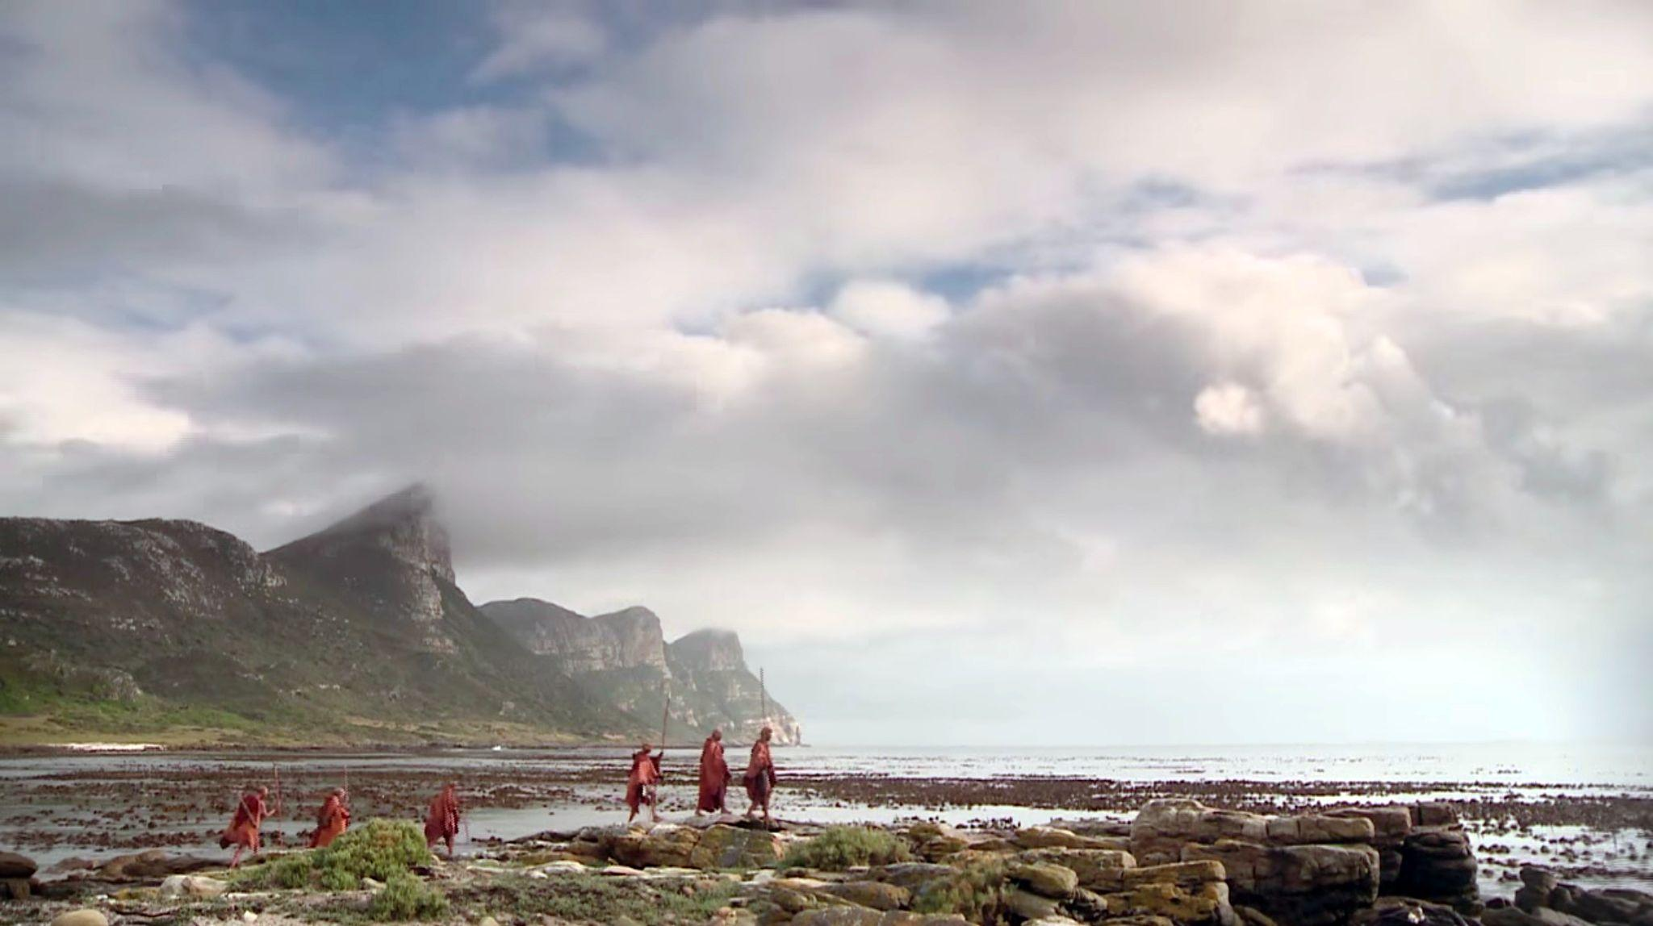
The significant role of South Africa
The southern Cape is significant to global understanding of symbolism and cognition of early humans
This heritage centre will highlight the role South African archaeological sites played in the cultural evolution of humans
More than 50 local & international scientists are involved in research projects along the Garden Route
International and local universities invested more than R700 million on future archaeological research projects in South Africa
The following sites are all on the World Heritage Site Tentative List:
Blombos Cave Diepkloof Shelter Pinnacle Point Site Complex Klasies River Sibhudu Cave Border Cave

Slide 9
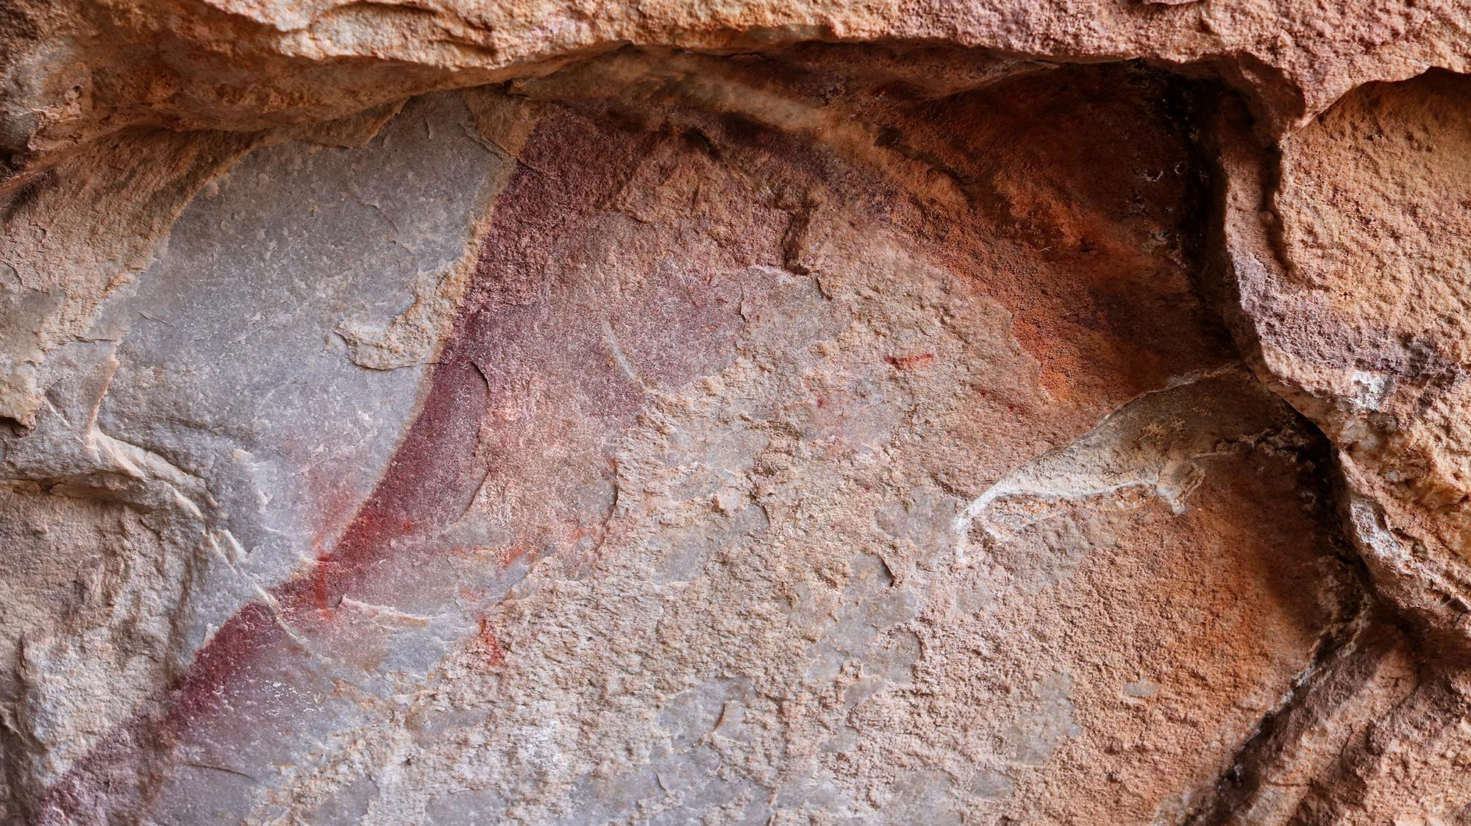
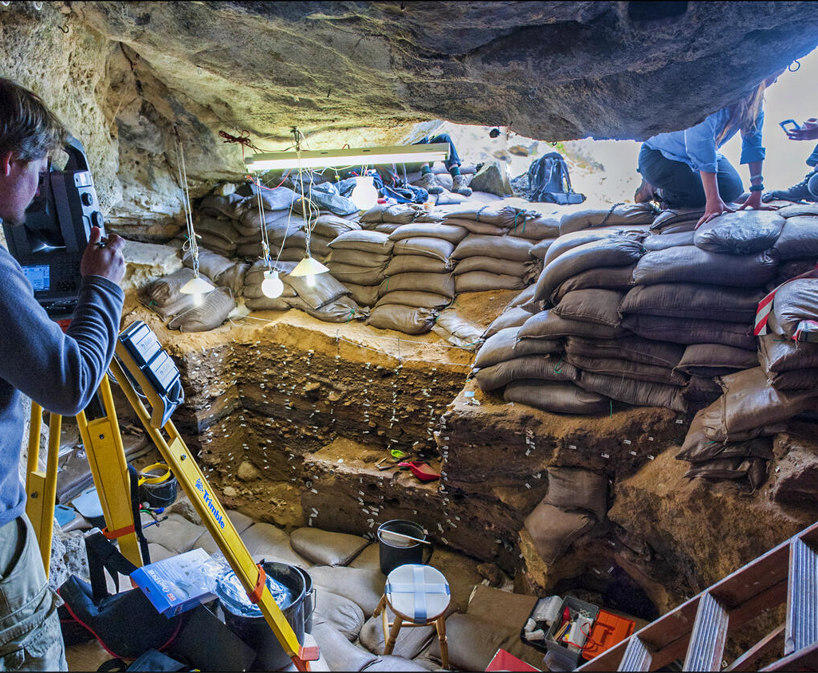
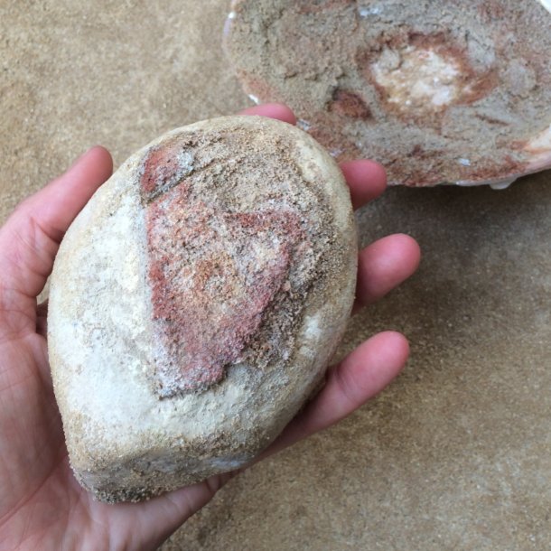
Laboratory, Research and Public Participation
The use of the laboratory and repository for future research and
assisting students and researchers
Public engagement and interaction
Live/active on-site laboratory
Outdoor Workshops for children archaeology and tool-making
Endemic edible plants – food to taste in the restaurant

Slide 10
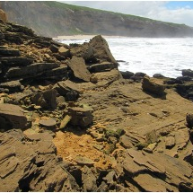
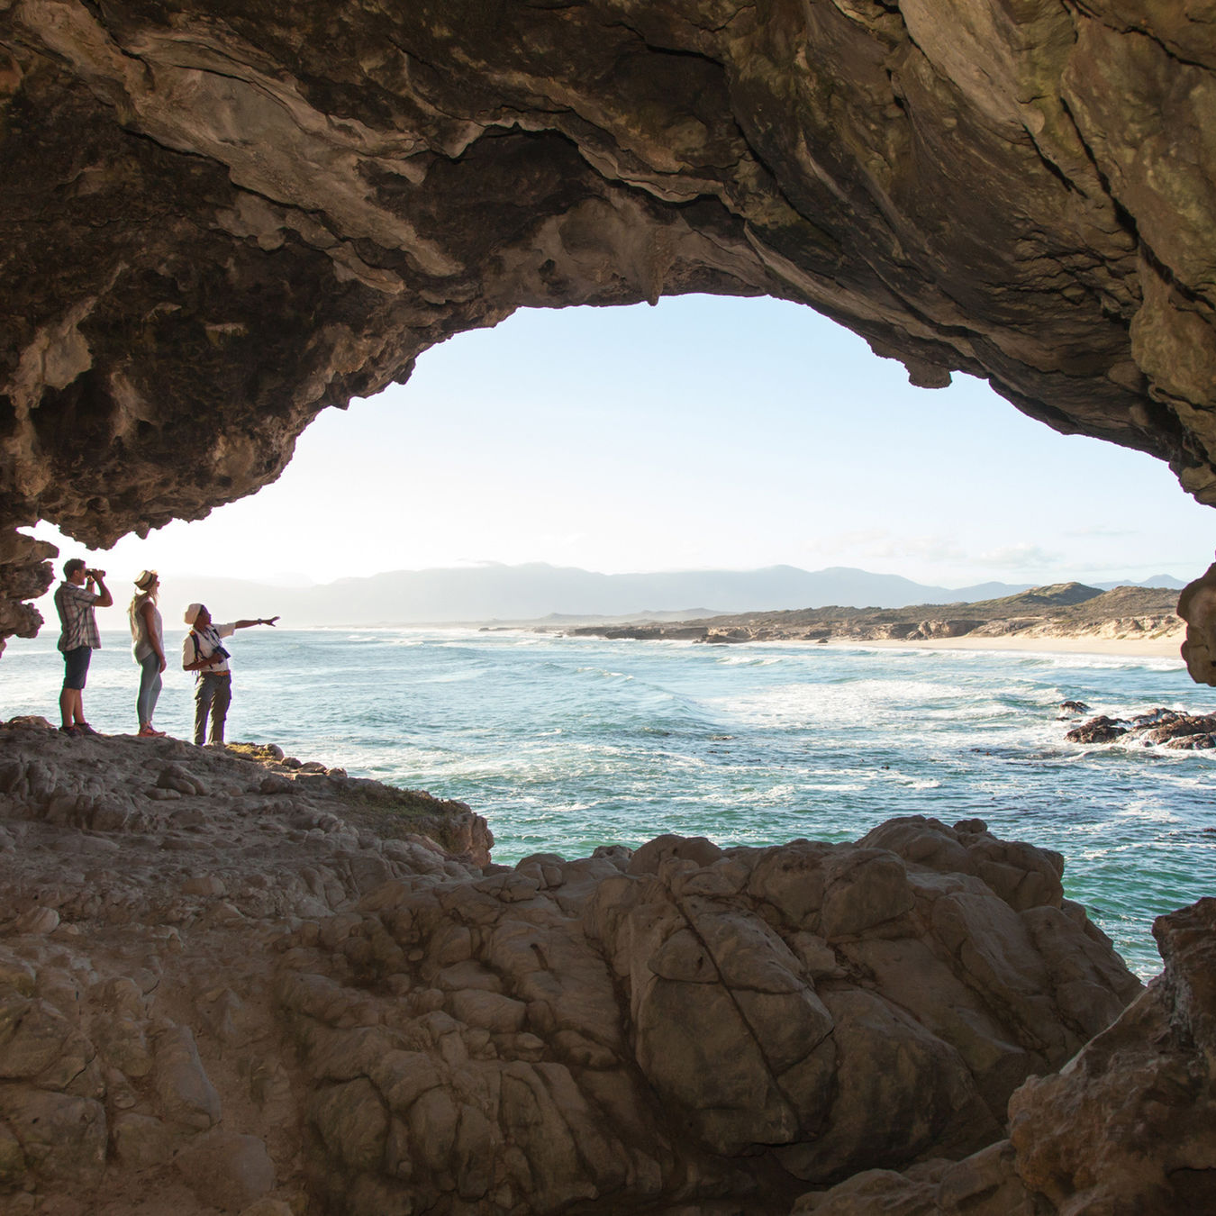
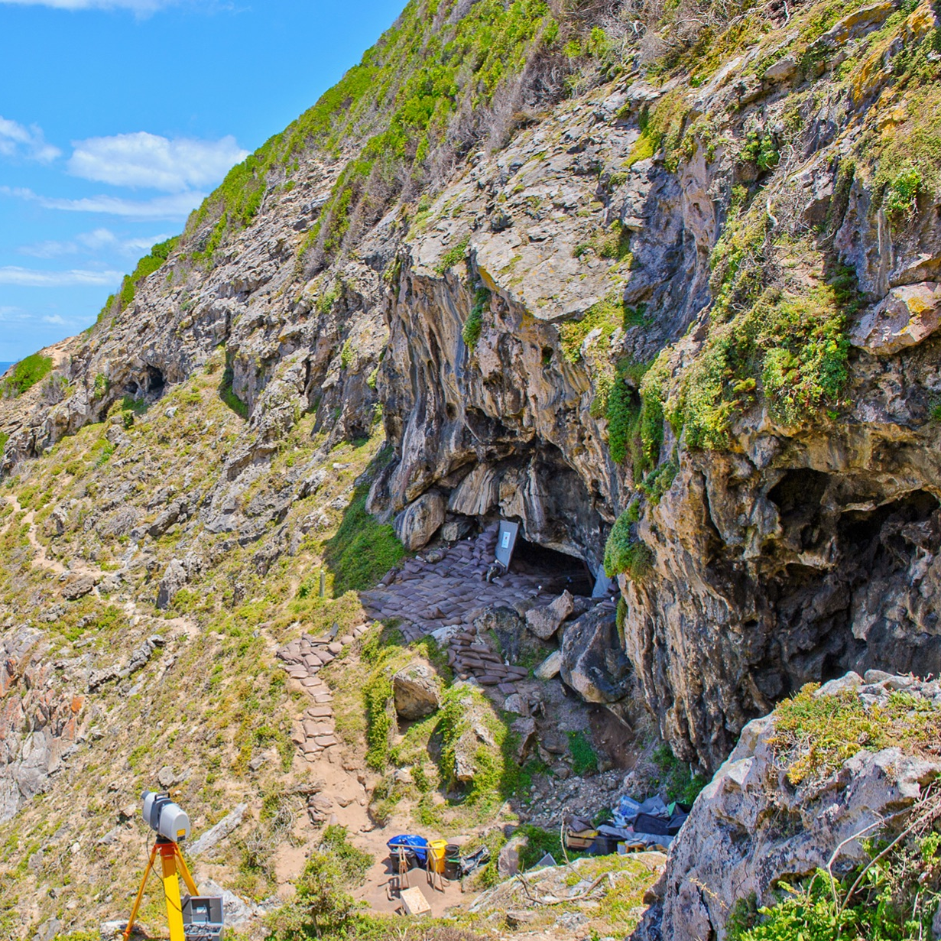
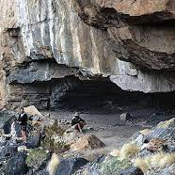
Timeline of archaeological contents
years
170,000 .
Ichnology and
Landscape
164,000.
Pinnacle Point caves
120,000.
Klasies River
100,000.
Blombos Cave
66,000.
Klipdrift Shelter
60,000.
Diepkloof Rock shelter
30,000.
Apollo 11 - earliest Rock Art site
2,000,0000 BCE.
Blombos Cave earliest known drawing done by a human in the world

Slide 11
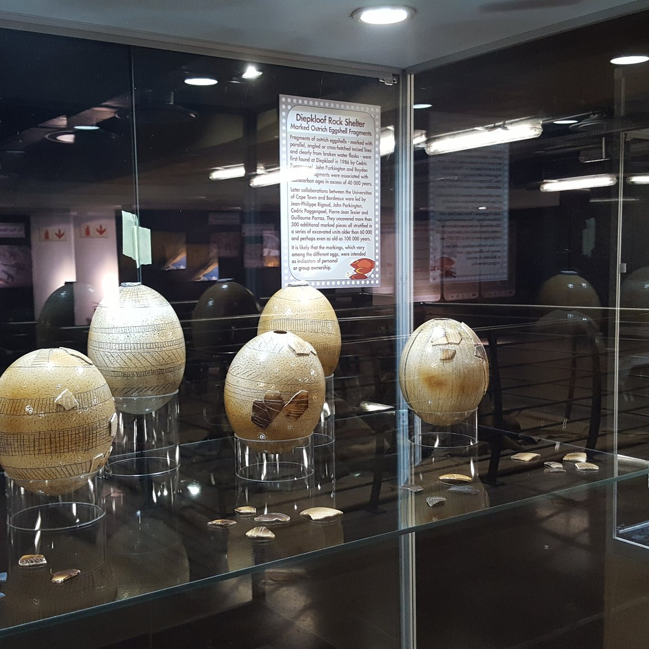
Why Stilbaai?
Hessequa Heritage Centre will be one of the main tourist attractions of the Garden Route
The Origins of Homo sapiens behaviour exhibition by renowned scientist, Professor Henshilwood:
will be permanently relocated to Stilbaai
and is a donation worth R1.7m from Wits University
Existing investment and value offered
The concept design is completed at a cost of R600 000
The Hessequa Municipality rezoned the property at no cost 8 000m² on Erf 657 value worth R7.3 million

Slide 12
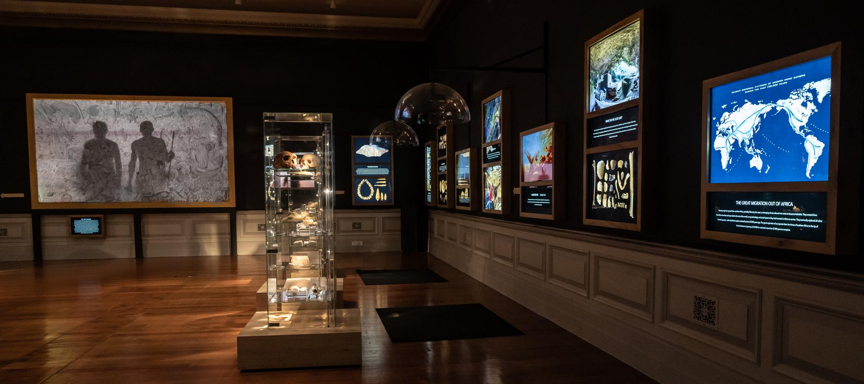
Why Stilbaai?
Stilbaai is a popular tourist and retirement destination
Some of the oldest and still the most significant discoveries of the emergence of modern human behaviour in the world come from Blombos Cave, near Stilbaai
Tourism. Hub for the.
Hessequa.
region.
Stilbaai attracts more than
80,000 visitors
per annum – numbers are expected to increase
Proximity to archaeological sites:.
Blombos Cave
Ichnology – trace fossils
Rock art
Fish traps
Shell middens
Craig Foster – Part of The Origins of Homo sapiens behaviour exhibition

Slide 13
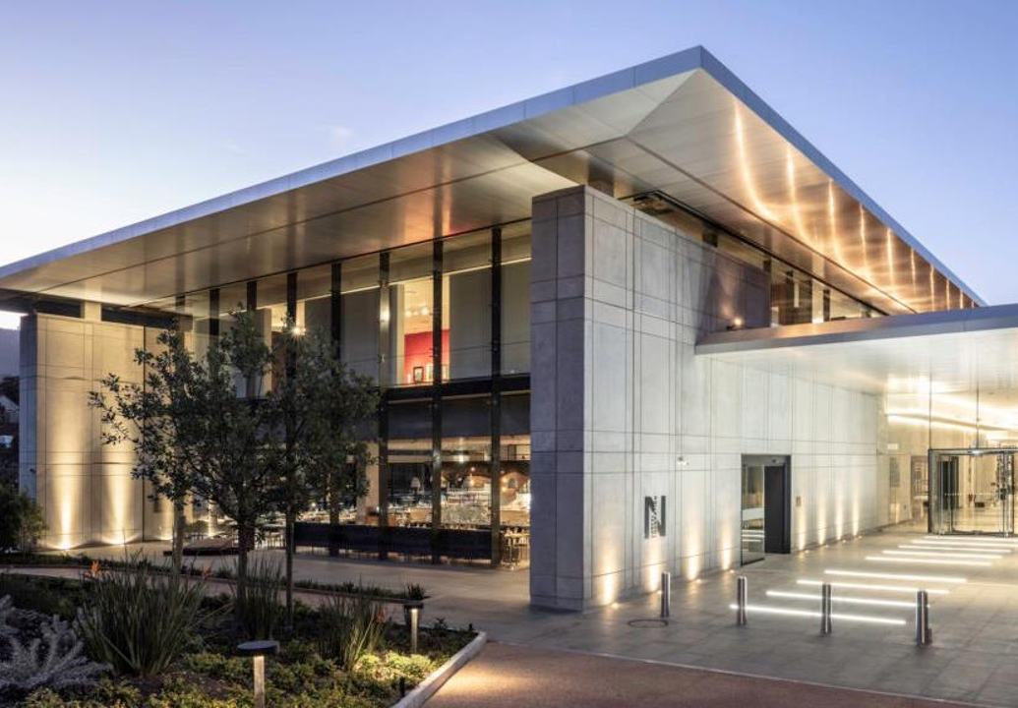
Tourism Statistics
Cape Garden Route and Klein Karoo – 2019
The Hessequa Heritage Centre for Archaeology
will facilitate job creation and tourism growth
within the local economy
OVERSEAS VISITORS 57.3%
DOMESTIC VISITORS 42.7%
The Norval Foundation and the West Coast Fossil Park are two successful museums established in the same way – donors sponsored the infrastructure and the funding models create an ongoing sustainable concern
Germany 32.2%
United Kingdom 21.6%
France 6.6%
Western Cape 29.9%
Gauteng 9%
Eastern Cape 6.1%
3
Culture and Heritage
TOP
Scenic drives
Beaches
21.9%
21%
12.8%
ACTIVITIES
NORVAL FOUNDATION
2018
WEST COAST FOSSIL PARK
2018

Slide 14
Our co-operative partners

Slide 15
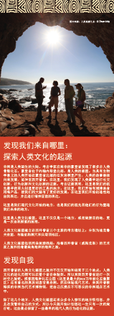
Planned marketing media
South Africa
International
Traveller 24
Getaway Magazine
Tourism Update
Cape Town ETC
BizCommunity
VisitKnysna
Better Tourism Africa
Destination Garden Route
SA Tourism Online
Showme
Nat Geo Africa Edition
WCG
IOL
SABC News
Mossel Bay Tourism
Sure Travel
Smile 904 FM
Afrol
Cape Talk 567
Cape Argus
Tourism Update
AA Traveller
Better Together
Discoverctwc
Suid Afrika Magazine
Maropeng website
SAT China virtual Roadshow
The Cradle of Human Culture was launched at the SAT China Roadshow in 2019 together with South African Tourism
Repurposed Cradle of Human Culture content were used to introduce the Cradle of Human Culture tourism route to 150 buyers.

Slide 16
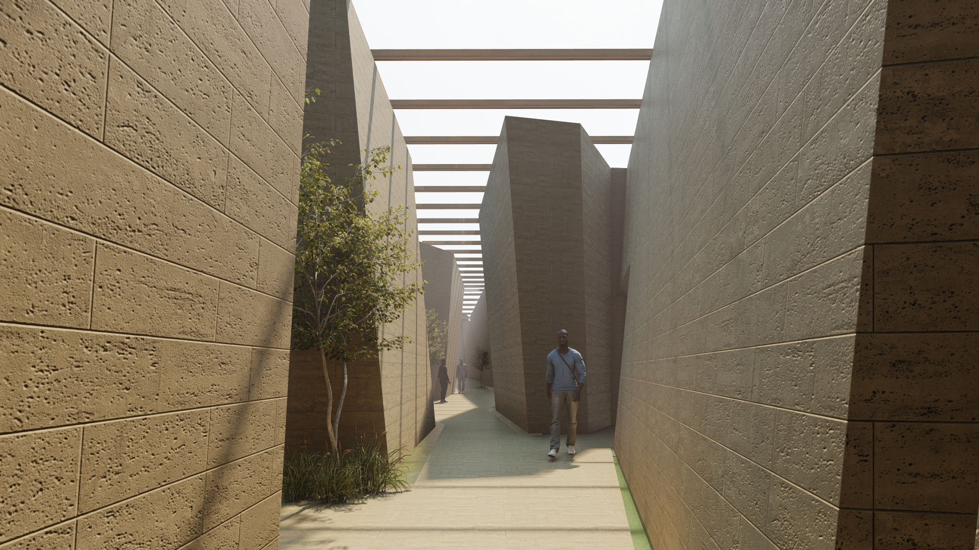
Proposed timeframes
Fundraising | Nov 2022 – Sept 2023
Detail design | Oct 2023 – Jul 2024
Construction | Sep 2024 – Sep 2025
Exhibition
Detail design and approval | Oct 2023 – May 2024
Manufacturing | Jun 2024 – May 2025
Installation | Jul 2025 – Sept 2024
Opening | Oct 2025

Slide 17
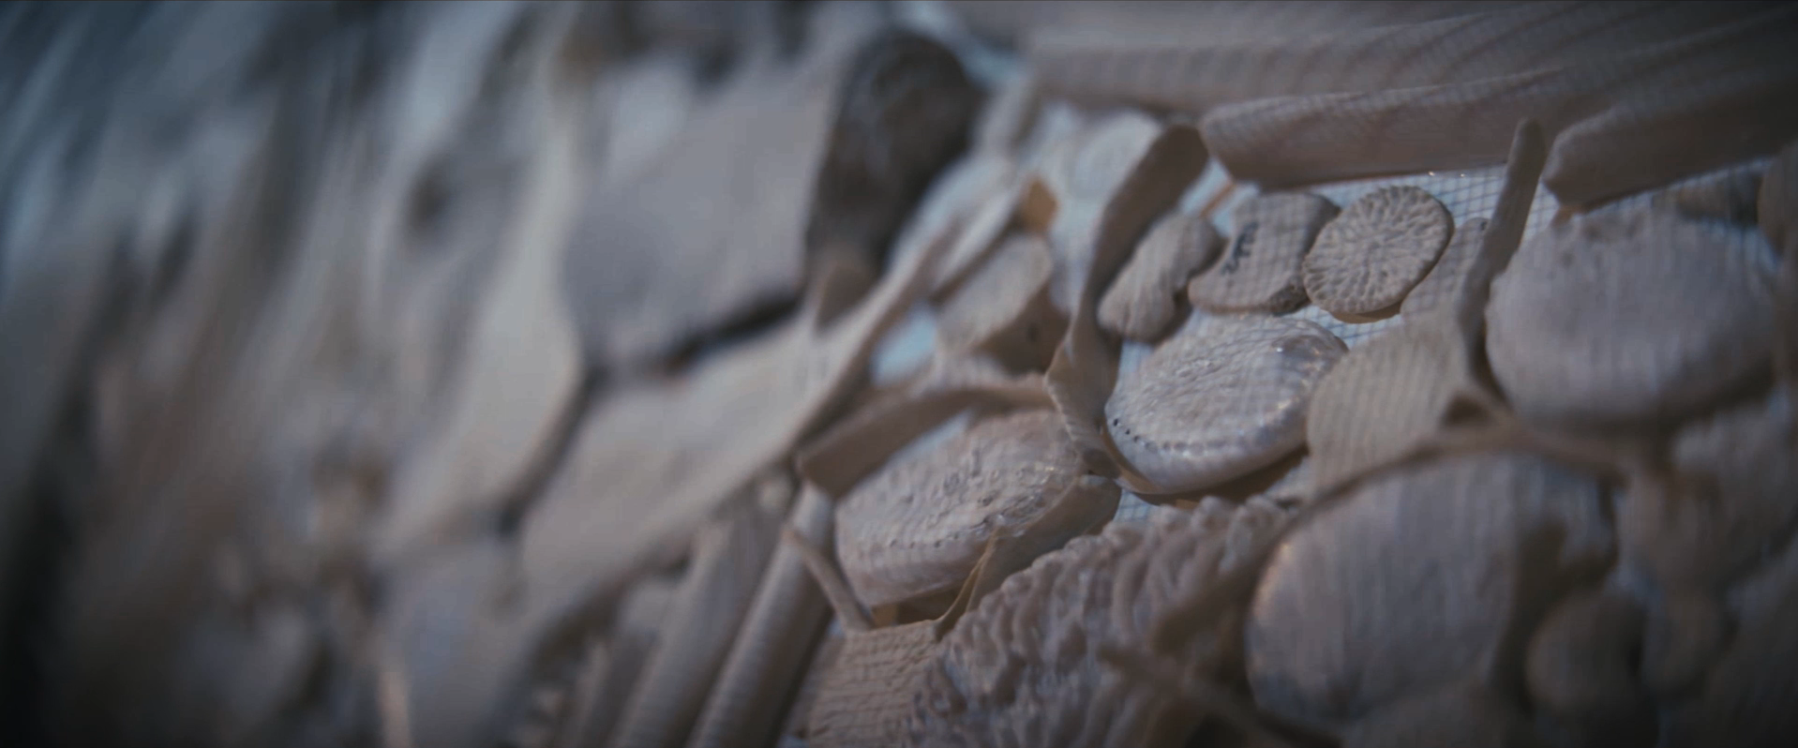
Cost summary
Design and construction
Construction | R31 539 240
Professional fees and disbursements | R5 695 380
Total design and construction |  | R37 234 620
Exhibitions
Exhibitions design & installations |  | R11 660 000
Conference facility
Conference hall accessories |  | R826 800
Contingency |  | R1 248 680
Total |  | R50 970 100
VAT |  | R7 645 515
Grand Total |  | R58 615 615
Grand Total
R58 615 615
€3 405 000
/
$3 850 000
Dependent on currency exchange

Slide 18
Financial feasibility
A feasibility study was performed by the Western Cape Government
This project will contribute to socio-economic empowerment and growth
The business plan indicates financial sustainability from inception
The parties below are convinced and sponsored R600,000. for the concept design:.
Wits university R200,000
Blombos and Fynbos trust R200,000
Western Cape Department of Cultural Affairs and Sport R200,000

Slide 19
Contribute to this project
FUNDING PROPOSAL
Your support, assistance and contribution to establish this unique facility will ensure that our heritage, our origins and our past are available to all
Progressive donations can be made as the project advances through its different stages
Project and funding managed by:
Blombos Archaeological and Fynbos Trust
Registration no IT002090/2017)C
Non-profit Organisation NPO 230-030
Donations are tax deductible in terms of
Section 18A(2B) and (2C), authorised tax certificates
Donor recognition:
The donor’s name may be displayed on a recognition board
Contact details:
Izak Venter
Blombos Archaeological and Fynbos Trust
Project Manager
+02782 808 3856
Blombos.Trust@HHCFA.org.za
Andre van Tonder
Blombos Archaeological and Fynbos Trust Chairperson
+2782 555 9448
Blombos.Trust@HHCFA.org.za

